Slide 1
Flask - Django
SE 3355 Web Development
Lect. Barış Ceyhan

Slide 2
Motivation - install
Flexible python based web development framework. Simplest possible
No particular project or code layout
Install is within minutes
https://www.google.com/search?q=create+simple+flask+in+VSCode
python -m venv venv
venv\Scripts\activate

Slide 3
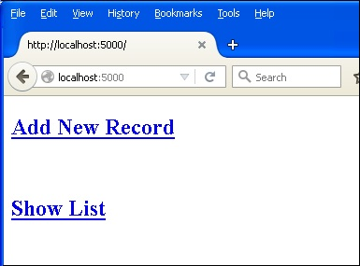
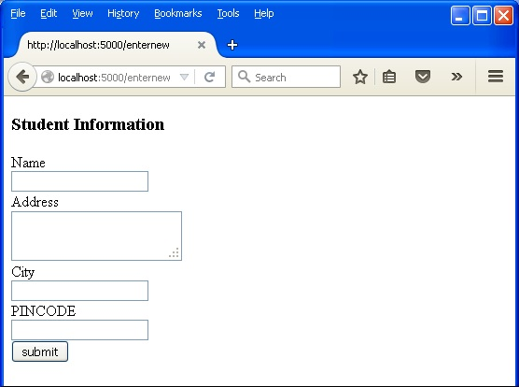
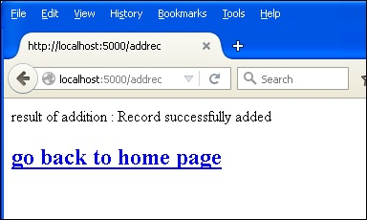
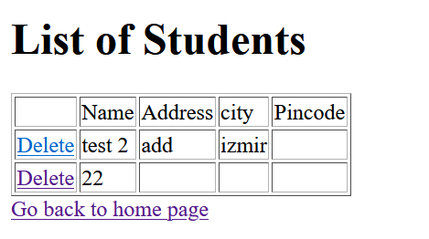
Lets do a simple project

Slide 4
For more complex projects
install
Project layout
Application Setup
Templates
Static files
Deploy
Review sample API application
Then https://flask.palletsprojects.com/en/3.0.x/tutorial/
See https://github.com/southriver/se3355-flask-webapp for classwork

Slide 5
Django
Robust security, full stack
Batteries included concept
Scalable
Not suitable from small projects
Both Flask and Django are free, open-source
Both Flask and Django allow you to map URLs to views
Flask doesn’t come with its own admin panel. (Extension Flask-Admin)

Slide 6
https://kinsta.com/blog/flask-vs-django/
https://www.w3schools.com/django/django_getstarted.php
Class based vs functional
https://medium.com/@ksarthak4ever/django-class-based-views-vs-function-based-view-e74b47b2e41b

Slide 7
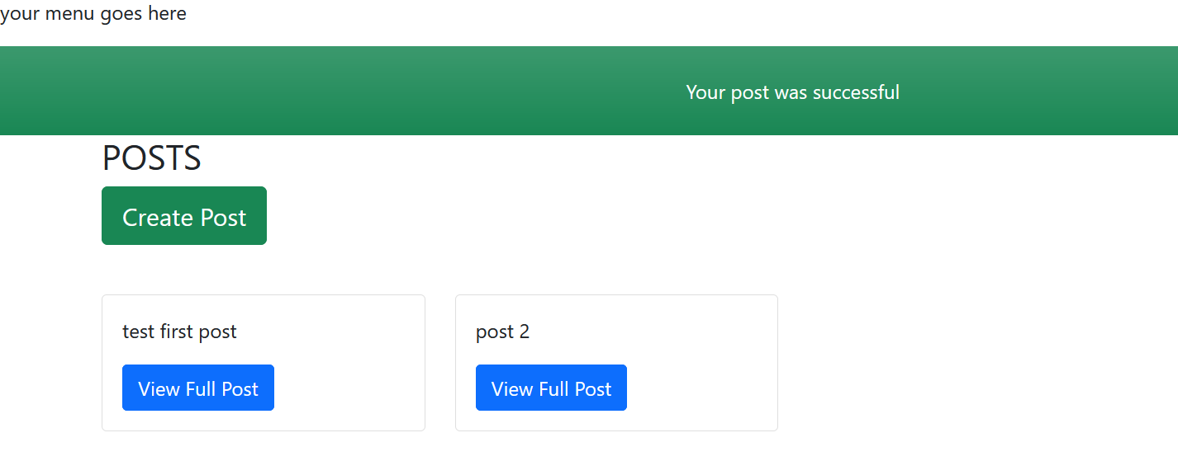
Lets create a simple Posts app

Slide 8
Installation – steps
-- install python (or extension)
-- install Django
python -m pip install Django
-- install virtual envi
py -m venv myworld
myworld\Scripts\activate
-- create project
django-admin startproject mysite .
py manage.py runserver
python manage.py migrate
python manage.py createsuperuser - republic
-- create app
-- An app is a web application that has a specific meaning in your project, like a home page, a contact form, or a members database
python manage.py startapp feed
→ put feed under installed apps in settings
--model
-- add to feed/Models.py and Admin.py
python manage.py makemigrations
-- add home view and url.py for feed and edit /urls.py
-- create baseDir in settings.py TEMPLATE_DIR
-- create home.html under templates
-- introduce base.html in home.html
-- refactor home.html
-- add detail view and templates
---- add to views and urls
-- add message

